Slide 1


Developing Predictive Models of U.S. Army Career Pathways
Joshua Goldstein, Principal Investigator
Social and Decision Analytics Division
Biocomplexity Institute
University of Virginia
Cooperative Agreement: W911NF2020027

Slide 2






Developing Predictive Models of U.S. Army Career Pathways
Joshua Goldstein, Principal Investigator
Cooperative Agreement: W911NF2020027
Overview: ARI, in collaboration with the Biocomplexity Institute’s Social and Decision Analytics Division of the University of Virginia, is developing statistical models of Soldier career progression based on existing Army administrative and survey data and other non-DOD data sources.
Leveraging expertise developed within the Person Data Environment (PDE)
Developing longitudinal characterization of Soldiers’ knowledge, skills, and abilities acquisition through incorporation of individual and contextual information
Exercise SDAD Data Science Framework
Model Career Pathways of Officers Using PDE Administrative Data
Explore Extending Models to Enlistees
Test Research Questions and models on data external to PDE
Develop Career Profiles through Grounded Theory
Fill Data and Model Gaps for Career Pathways Soldier Progression

Slide 3
Developing Predictive Models of U.S. Army Career Pathways
Joshua Goldstein, Principal Investigator
Cooperative Agreement: W911NF2020027
Conceptual Framework
Initial Inputs
Predictors & covariates present prior to or at Soldier accession
Primary Questions:​
Do we have access to this data?​
If not, where and how do we get it?​
Career Pathways​
Predictors & covariates that occur during Army career; interactive & iterative​
Primary Questions:​
Do we have access to this data?​
How is it best represented in our models?
Are new models needed?
End States
Soldier endstate at separation from the Army, i.e., end point of career
Primary Questions:​
Do we have access to this data?​
How is it best represented in the models?

Slide 4
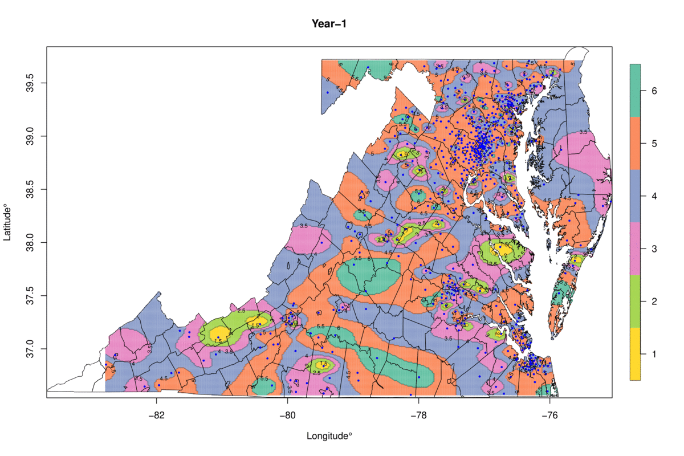
Developing Predictive Models of U.S. Army Career Pathways
Joshua Goldstein, Principal Investigator
Cooperative Agreement: W911NF2020027
Bayesian Multinomial Models
Bayesian Multinomial Logistic Regression (MNL) model with increasing complexity to capture
Impact of covariates featuring individual level history/experience on career transitions
Quantify spatial and temporal variation
Probit link allows for a continuous modeling of job states and transitions
Spatiotemporal Extensions
Spatiotemporal variation in the Burning Glass Technologies (BGT) data for year-to-year transitions within the various job zones. NOTE: BGT is now Lightcast

Slide 5
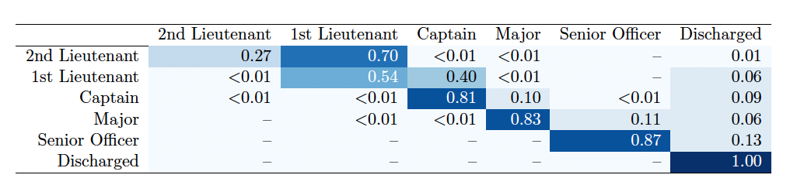
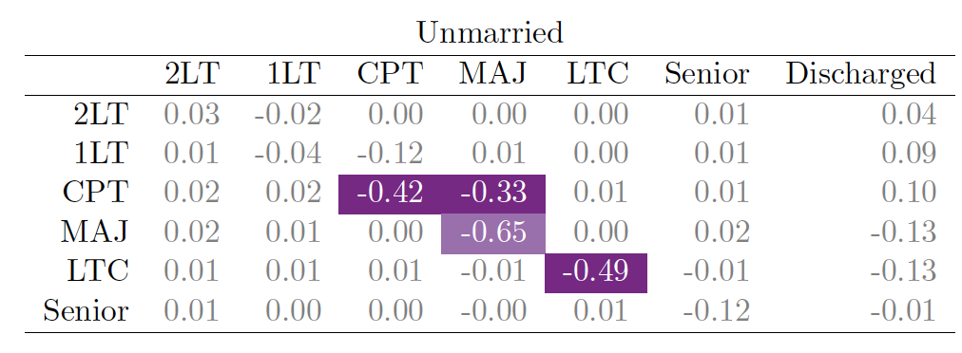
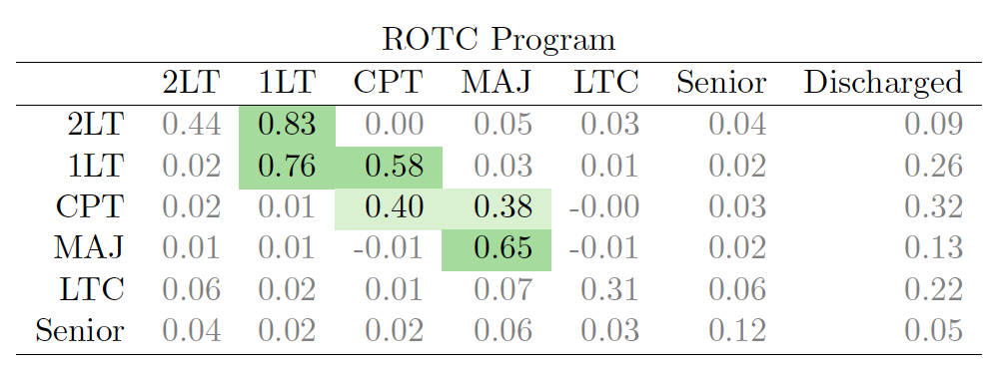
Developing Predictive Models of U.S. Army Career Pathways
Joshua Goldstein, Principal Investigator
Cooperative Agreement: W911NF2020027
Selected Modeling Results
Reference group for selection source: Direct Commision
Total overall year-to-year transition probabilities between Army Officer ranks as estimated by the Multinomial Logistic Regression (MNL). Speed of transitions are influenced by covariates; e.g., marital status, selection source.

Slide 6
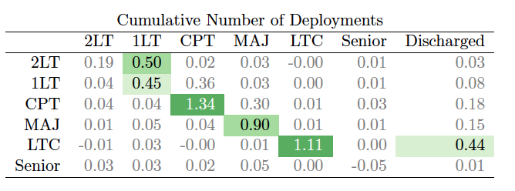
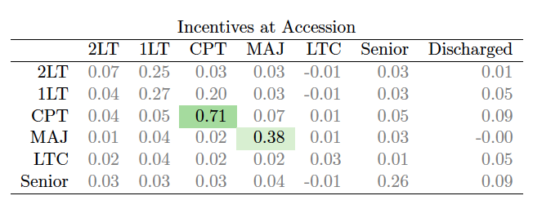
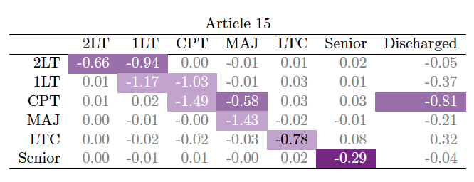
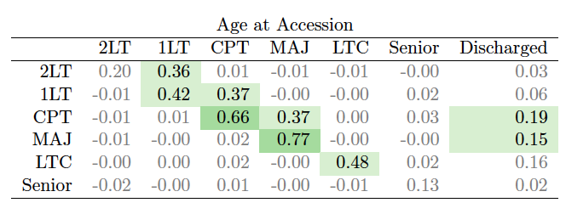
Developing Predictive Models of U.S. Army Career Pathways
Joshua Goldstein,Principal Investigator
Cooperative Agreement: W911NF2020027
Selected Modeling Results
Higher age at accession, number of deployments, and incentives at accession are associated with faster promotions. “Bad papers” (e.g., Article 15, Letters of Reprimand) are associated with slower time to promotion.

Slide 7
Developing Predictive Models of U.S. Army Career Pathways
Joshua Goldstein, Principal Investigator
Cooperative Agreement: W911NF2020027
Current/Next Steps
Continue to build on this framework using administrative data on Army Officers in the PDE.
Define career states using detailed duty position descriptions from Officer Evaluation Reports. This allows us to go beyond rank and MOS.
Proposed Year 4 project extensions:
Apply this modeling framework to the Army enlisted population.
Build in data on recruiting stations and the influence of the recruiting process on career pathways.

